Slide 1
The Oregon Dunes
A Vanishing Landscape

Slide 3
Where are the dunes?
Four regions…
Region One – 73 miles. 55 miles north of Columbia River (WA) to Tillamook Head.
Region Two – 125 miles. Tillamook Head to Heceta Head.
Region Three – 54 miles. Heceta Head to Coos Bay. (ODNRA – focus of this talk)
Region 4 – 130 miles. Cape Arago to California border.
Notes:
Four regions of dunes – making up about 45% (or 140 miles) of our 310 mile coastline.
Broken up into four regions.
This talk focuses on the 54 miles between Heceta Head and Coos Bay. Chosen as the ODNRA because it is the least broken up by rivers and forest.
It was founded in 1972 as a way to protect the tallest and largest expanse of coastal sand dunes in North America.

Slide 4
Why are they here?
Recipe for an Oregon dune…
Ingredients:
LOTS of sand
STRONG wind
FLAT coastline
Directions:
Distribute sand on shoreline
Add wind
Move sand inland
Bury all in path
Notes:
So why are they here? Well, if I was going to cook up an Oregon dune, it would look something like this…
We know that the majority of the sand on our dunes is from the Cascade Mountain range and was delivered here by the Umpqua River. The Coast mountains and other rivers have contributed, but a study of the make-up of our sand shows that the majority of it matches rocks found in the Cascade Mountains.

Slide 5
What’s there?
Unique ecosystem relies on wind
Dune Formations
Native Plants
Over 400 Species of Wildlife
Notes:
The Oregon dunes is a unique ecosystem because it relies on the movement of sand by wind to thrive. The plants and animals that call this place home are adapted to this ever-shifting environment and, in fact, some of the plants and animals rely on it.

Slide 6
Structure of a Healthy Dune System
Beach
Deflation Plain
Tree Island
Retention Ridge & Forest
Transverse
Dunes
Oblique
Dunes
Foredune
Notes:
What does a healthy functioning dune system look like…
A healthy system is made up of open sand and these features… A LOW foredune that historically was created by native plants that die off in winter and would allow the foredunes to wash away in winter storms; additionally, we had sandy deflation plains that did have some wetlands (due to aquifers and native plants), but not the dense forest that we see today.

Slide 7
A healthy dune system has…
Large Oblique Dunes
Yardangs
Transverse Dunes
Among other things…
Notes:
A healthy dune system includes the following topography (formations)…
CLICK TO LOAD PHOTOS AS YOU LIST FORMATIONS IN THIS ORDER:
Large oblique dunes (photo already on slide)
Yardangs
“Waves” of transverse dunes

Slide 8
A healthy dune system has…
Notes:
A healthy dune system has these things as well…
CLICK TO LOAD PHOTOS AS YOU LIST FORMATIONS IN THIS ORDER:
Ghost forests (photo already showing)
Tree islands
Seasonal ponds/wetlands
Native plants
Tree islands are remnants of older forests that were not buried by sand or where sand movement allowed them to develop. Important for wildlife. Often have springs on west sides that provide water.
Ghost forests are formed as sand moves inland and buries the forest.
Seasonal ponds are formed in winter when heavy rain causes aquifers to rise up…in summertime, water levels drop again.

Slide 9
An unhealthy dune system has…
Tall, Stable Foredunes
Large Deflation Plains/Wetlands
Hummocks
Notes:
An unhealthy system looks more like what we see in many places today on the Oregon dunes…
If you talk about them here, mention some or all of these things:
How grass grows to create foredunes (first, native American Dune grass would lay over in wind allowing sand to pass; second, when stiff European beachgrass captures sand and gets buried, it sprouts new rhizomes/roots where buried and then grows taller…process repeats until foredunes become tall).
Foredunes now 30 feet talk (have lost “flat coastline” ingredient from recipe…like making bread without yeast).
Foredunes causing spread of dense deflation plain (as sand blows inland, no new sand is able to get past the “grass cliff” – now we have hit water table behind foredunes and there is very little sand movement…ideal conditions for forest to begin growing. What do you think will happen as the remaining sand moves inland? Yes, deflation plain will get larger as shown in the aerial photos on the poster I brought in).
This has also created habitat for animals that were not normally here (e.g., Pacific Marten…need to confirm name…they have changed it).
Additionally, animals that rely on open sand are now losing habitat as well as native plants that rely on shifting sands (native plants are important for the animals that live there…lose the plants, lose the animals).
Grass is also spreading across open sand (discuss hummocks, if not already done…the larger the hummock, the older it is).
Roots are now a layer cake of roots (due to how rhizomes sprout as grass is covered). Rhizomes are up to 25 feet long with many branches and as thin as your hair…break off when grass is pulled (has anyone tried to pull out this grass before? Do you get 25 foot long roots? No, you don’t…they are left in the ground to sprout again).
Layer cake roots may be 20, 30, or much more deep.
There are no biological controls for non-native plants…the animals and insects that live on the dunes have eaten native plants for thousands of years…they are not adapted to eating these newcomers (from the last 50 to 100 years).
The grass also takes away habitat for native plants.
Finally, some say that if we opened all areas to OHV riding, that would kill off the grass. It is true that many riding areas have less grass because it is kept at bay, but also kept at bay are native plants…there are very few native plants in riding areas as well. Wildlife is also pushed out of riding areas. We need both…OHV areas and non-OHV areas to maintain a healthy ecosystem.

Slide 10
1930’s CCC Planting
1948? Mechanical Planting
How did it get here?
1970’s Private Planting
Planting began in late 1800’s
1930’s-1950 large-scale government plantings (no USFS plantings after 1950)
Other plantings continued past 1950
Private plantings continue today

Slide 11
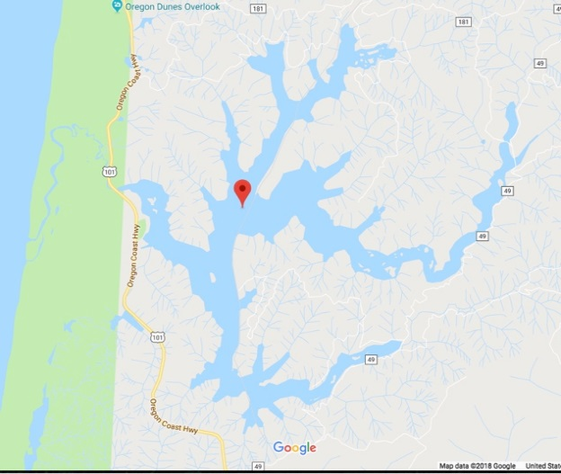
Why did we plant it?
Dunes were a “wasteland”
Infrastructure problems
Dust Bowl fears
Moving sand…
Caused Flooding
Blocked/Altered Rivers
Buried Roadways/Structures
Notes:
Keep in mind that we were depending on waterways to get supplies into Florence prior to the completion of Highway 101. Moving rivers made it difficult for boats to come into ports. Highway 101 was built in the 1930’s and moving sand would block roadways. Sand blocking streams and rivers caused flooding. Additionally, the Oregon dunes were not considered important at that time...when the land was considered valuable only for the resources it provided. It was considered wasteland. They tried planting timber there and they also planted barley in hopes of attracting geese for hunting. It was not considered for ecological value or tourism or recreational value at that time. Additionally, what else was going on in the 1930’s? The dustbowl (1930-1936)…so blowing/moving sand was perhaps of a greater concern than we might realize today.

Slide 12
A growing problem with beachgrass
Notes:
How grass grows to create foredunes (first, native American Dune grass would lay over in wind allowing sand to pass; second, when stiff European beachgrass captures sand and gets buried, it sprouts new rhizomes/roots where buried and then grows taller…process repeats until foredunes become tall).
Foredunes now 30 feet tall (have lost “flat coastline” ingredient
Foredunes causing spread of dense deflation plain (as sand blows inland, no new sand is able to get past the “grass cliff” – now we have hit water table behind foredunes and there is very little sand movement…ideal conditions for forest to begin growing. What do you think will happen as the remaining sand moves inland? Yes, deflation plain will get larger as shown in the aerial photos.
This has also created habitat for animals that were not normally here (e.g., Pacific Marten).
Additionally, animals that rely on open sand are now losing habitat as well as native plants that rely on shifting sands (native plants are important for the animals that live there…lose the plants, lose the animals).
Grass is also spreading across open sand (discuss hummocks, if not already done…the larger the hummock, the older it is).
Roots are now a layer cake of roots (due to how rhizomes sprout as grass is covered). Rhizomes are up to 25 feet long with many branches and as thin as your hair…break off when grass is pulled (has anyone tried to pull out this grass before? Do you get 25 foot long roots? No, you don’t…they are left in the ground to sprout again).
Layer cake roots may be 20, 30, or much more deep.
There are no biological controls for non-native plants…the animals and insects that live on the dunes have eaten native plants for thousands of years…they are not adapted to eating these newcomers (from the last 50 to 100 years).
The grass also takes away habitat for native plants.
Finally, some say that if we opened all areas to OHV riding, that would kill off the grass. It is true that many riding areas have less grass because it is kept at bay, but also kept at bay are native plants…there are very few native plants in riding areas as well. Wildlife is also pushed out of riding areas. We need both…OHV areas and non-OHV areas to maintain a healthy ecosystem.

Slide 13
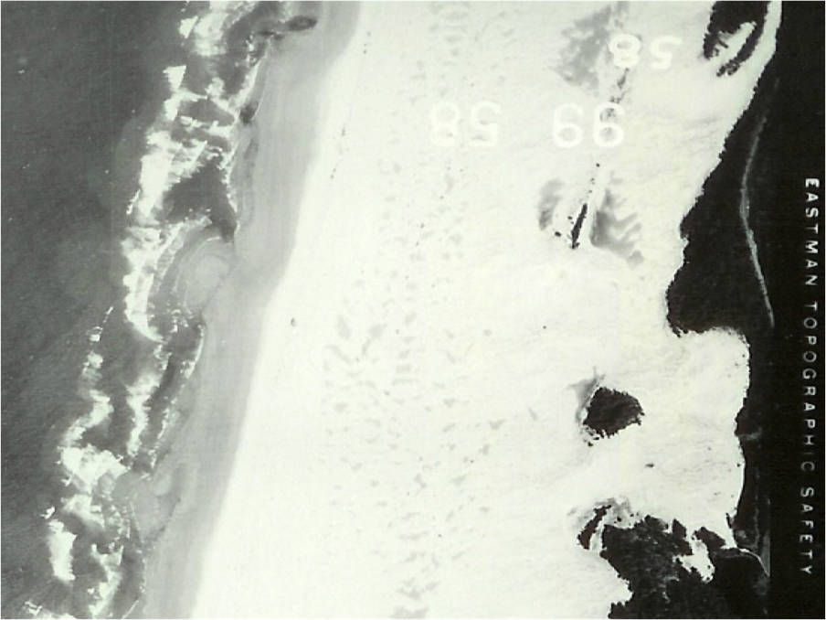
The Oregon Dunes Then & Now!
1930 Umpqua Dunes
2003 Umpqua Dunes
Day Use Area 1941 & 2006
Notes:
These photos give you an idea of how things have changed over time.

Slide 14
Do we care about losing them?
Notes:
Sometimes people say…who cares if we lose the open sand? The time, energy and expense are not worth the investment to save them. So I ask them a few questions…

Slide 15
Do we care about wildlife and a balanced ecosystem?
Notes:
Losing one native plant or animal may impact other plants and animals and we will lose them as well (or lose their biological controls). The result can be an exponential loss or negative change to our coastal ecosystem. The animals shown here are three either endangered or threatened species: Snowy Plover, Siuslaw Hairy-necked Tiger beetle, Pacific Marten.

Slide 16
Do we care about losing native plants and animals?
Notes:
From top left to lower right:
Snowy plover
Osprey
Yellow sand-verbena
Bald eagle
Seashore lupine
Black bear
Bobcat
Coastal strawberry
Beach carrot

Slide 17
Do we care about recreation?

Slide 18
Do we care about education and economy?

Slide 19
Tourism is an important factor in creating a healthy and thriving Siuslaw region
Over 1 million people visit the Oregon dunes annually!
Notes:
West Lane County is shown at far right.
This is all tourism, not specific to dunes, but dunes tourism is one of our main draws to this part of the coast.

Slide 20
How about that intangible thing?
Notes:
Finally, if you don’t care about any of the other things, what about that intangible thing…that feeling you get when you first walk out on the open sand.

Slide 21
YES! For many reasons, they are worth saving!
Notes:
So…YES! For many, many reasons, the Oregon dunes are worth saving.

Slide 22
People care in different ways and for different reasons! But we all agree – we must save this place!
Notes:
People care in different ways…

Slide 23
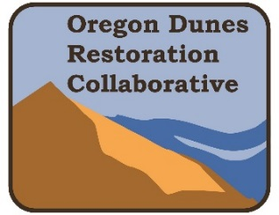
2014 - Oregon Dunes Restoration Collaborative (ODRC) is born!
Notes:
Enough people believed this place was worth saving and so the Oregon Dunes Restoration Collaborative was born.

Slide 24
Who are we?
Confederated Tribes of the Coos, Lower Umpqua and Siuslaw Indians
Douglas and Lane County Boards of Commissioners
Offices of Senators Merkley and Wyden
Oregon Wild
Save the Riders Dunes
Siuslaw National Forest
Siuslaw Watershed Council
Travel Lane County
Numerous Concerned Citizens and Volunteers
Notes:
The ODRC was born out of an initial gathering of stakeholders. In 2014, the Siuslaw National Forest convened a group of stakeholders to find out if we could work together to save this precious place. The most amazing thing happened…groups that often butted heads and could not see eye to eye (e.g., OHV riders and environmental groups) gathered and all of us agreed on one thing from the start…the dunes we loved and depended on economically and ecologically were disappearing and something needed to be done very soon or they would be lost forever. Yes, there were sometimes arguments and disagreements, but with a common goal that was important to each of us, we found ways to work together and listen to one another. Soon, the plan took shape. The group quickly realized that there needed to be an on-going effort to make this work and the Oregon Dunes Restoration Collaborative was born.

Slide 25
Goals of the ODRC
Preserve the Best
Restore Site-specific Conditions and Processes
Restore Landscape-scale Natural Processes
Notes:
ODRC developed a restoration plan to save the dunes. Knowing we can never completely get rid of the grass and other invasives, the group narrowed down the plan to three key points…
Preserve the Best – maintain and protect existing areas known to be in a healthy, natural condition.
Restore Site-specific Conditions and Processes – restore and maintain smaller areas to improve natural conditions at a local level.
Restore Landscape-scale Natural Processes – Create and maintain areas where there is a high likelihood that restoration of natural processes and natural landscape pattern will be successful.
We believe that restoring the dunes will be a decades-long effort and the ODRC is in it for the long haul, sustained by the passion of those whose hearts and minds are connected to this special place.

Slide 26
2018 – ODRC releases coffee table book and website in conjunction with USFS Restoration Plan
YOU can help!
Buy a book – at the Chamber or online
Volunteer – boots on the ground or get the word out
Educate – tell others about the Oregon dunes
Donate – restoration and maintenance require time and money
Join the ODRC – get updates; help us save this national treasure
Visit saveoregondunes.org
Notes:
In February of 2018, we released our restoration plan in the form of a coffee table book that can be downloaded for free from our website, saveoregondunes.org. At this website, you can obtain information about the group and how you can get involved. There are a number of ways you can help, and not all of them require boots on the ground or money. Simply educating the public and getting the word out will help. This will help to create a swell of caring to push the wave in the direction of restoring this unique and beautiful landscape that we all enjoy and from which we all benefit.
ODRC accepts $10 donations for the Restoration Book:
$10/book
$7 goes back to reprinting
$3 goes to restoration efforts

Slide 27
“Teamwork – cooperative or combined effort of a group of persons working together as a team for a common cause.”
SaveOregonDunes.org
“Alone we can do so little; together we can do so much.” – Helen Keller
“When you hand good people possibility, they do great things.” ― Biz Stone
"Unity is strength. . . when there is teamwork and collaboration, wonderful things can be achieved." --Mattie Stepanek
"Coming together is a beginning, staying together is progress, and working together is success." – Henry Ford
Notes:
Through collaboration and teamwork, we can be successful!

